Slide 1
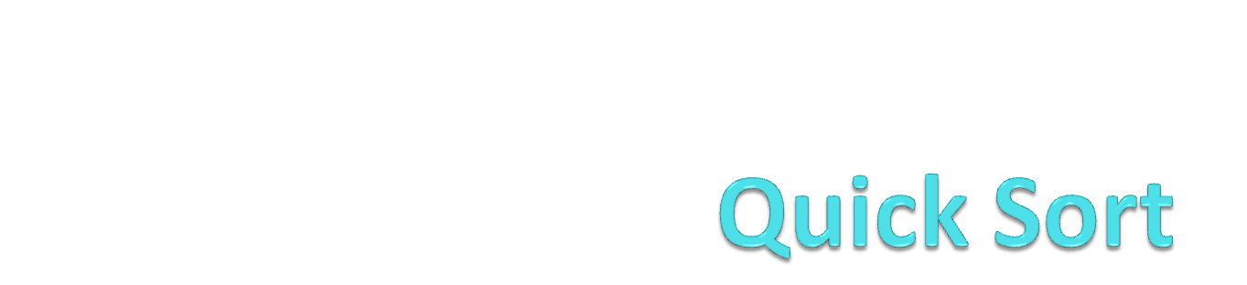
(Partition-exchange sort)

Slide 2
Quick Sort
Like Merge Sort, QuickSort is a Divide and Conquer algorithm. It picks an element as pivot and partitions the given array around the picked pivot.

Slide 3
Pivot Element
There are many different versions of quickSort that pick pivot in different ways.
Always pick first element as pivot.
Always pick last element as pivot .
Pick a random element as pivot.
Pick median as pivot.

Slide 4
Methodology Adopted
The key process in quickSort is partition().
Target of partitions is, given an array and an element x of array as pivot, put x at its correct position in sorted array and
put all smaller elements (smaller than x) before x,
and put all greater elements (greater than x) after x
All this should be done in linear time.

Slide 5
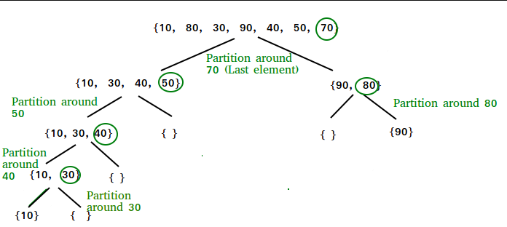
Example

Slide 6
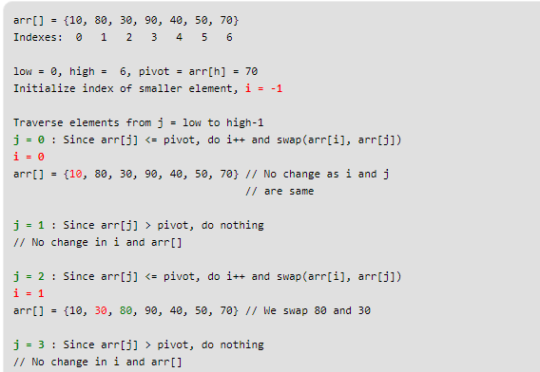
Basic Concept of partition

Slide 7
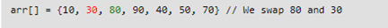
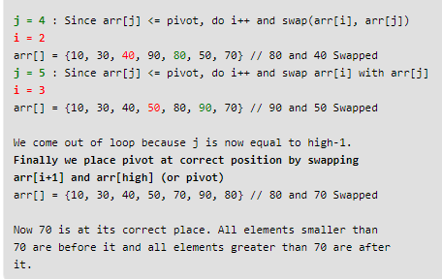
Continue…

Slide 8
Revisited…

Slide 9
Algorithm for partition
partition (arr[], low, high)
{ // pivot (Element to be placed at right position)
pivot = arr[high];
i = (low - 1) // Index of smaller element
for (j = low; j <= high- 1; j++)
{ // If current element is smaller than or equal to pivot
if (arr[j] <= pivot)
{
i++; // increment index of smaller element
swap arr[i] and arr[j]
}
}
swap arr[i + 1] and arr[high])
return (i + 1)
}

Slide 10
Algorithm
/* low --> Starting index, high --> Ending index */
quickSort(arr[], low, high)
{
if (low < high)
{
/* pi is partitioning index, arr[pi] is now at right place */
pi = partition(arr, low, high);
quickSort(arr, low, pi - 1); // Before pi
quickSort(arr, pi + 1, high); // After pi
}
}

Slide 11
Analysis of QuickSort
Time taken by QuickSort in general can be written as following.
T(n) = T(k) + T(n-k-1) +THETA (n)
The first two terms are for two recursive calls, the last term is for the partition process. k is the number of elements which are smaller than pivot.
Worst Case:
The worst case occurs when the partition process always picks greatest or smallest element as pivot.
If we consider above partition strategy where last element is always picked as pivot, the worst case would occur when the array is already sorted in increasing or decreasing order. Following is recurrence for worst case.

Slide 12
Worst Case
Worst Case:
The worst case occurs when the partition process always picks greatest or smallest element as pivot.
If we consider above partition strategy where last element is always picked as pivot, the worst case would occur when the array is already sorted in increasing or decreasing order. Following is recurrence for worst case.
T(n) = T(0) + T(n-1) + THETA (n)
which is equivalent to
T(n) = T(n-1) + THETA(n)

